Slide 1





Rimberio
Twitter Sentiment Analysis on Public Reactions
Made by: Deshna Nitin Tendulkar
(24070126051)
Harsh Jain (24070126065)
Harshad Agrawal (24070126068)

Slide 2


Introduction
Sentiment analysis is the process of determining the emotional tone behind a body of text. It is commonly applied in social media monitoring to interpret public sentiment toward events, products, or services. This project focuses on analyzing sentiments expressed on Twitter to gauge public reactions on various trending topics. By leveraging machine learning techniques, we aimed to classify tweets into Positive, Negative, Neutral, and Irrelevant categories, offering a comprehensive view of online public opinion.
To achieve this, a combination of Python-based tools and libraries was used. Data preprocessing and analysis were carried out using Pandas and NumPy, while text cleaning was performed with NLTK. Matplotlib and Seaborn were used for data visualization, helping uncover sentiment distributions and trends. Machine learning models were implemented using scikit-learn, allowing us to train and evaluate classifiers for sentiment detection. The entire workflow was managed in a Jupyter Notebook, with additional insights derived from an Excel-based dataset for entity-level sentiment tracking. These tools together enabled a thorough and scalable sentiment analysis pipeline.

Slide 3

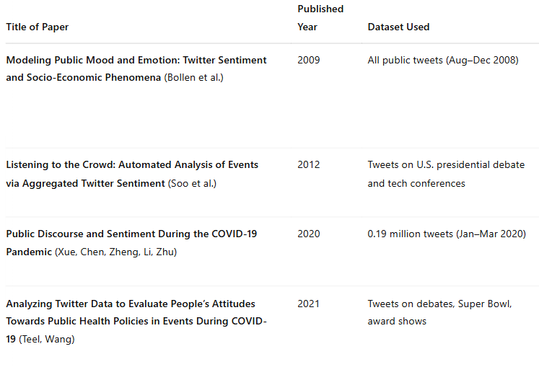
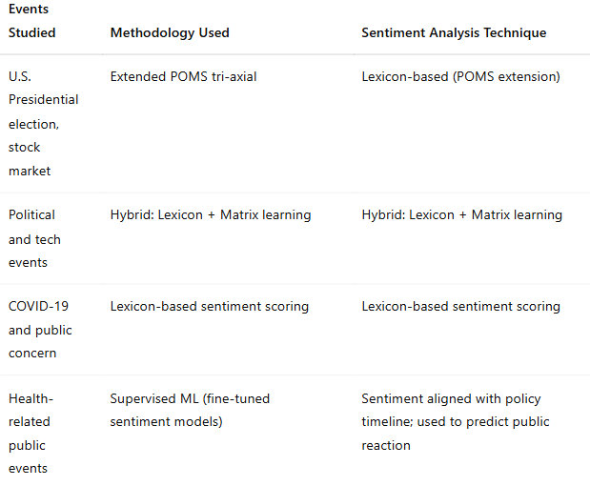

Rimberio
Literature Review

Slide 4
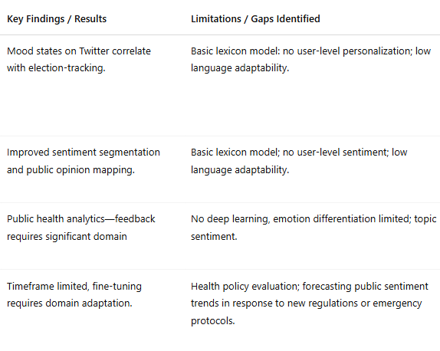
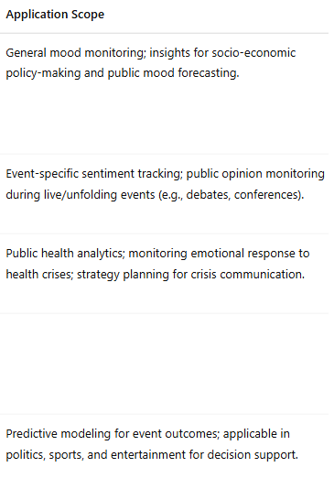
Rimberio

Slide 5
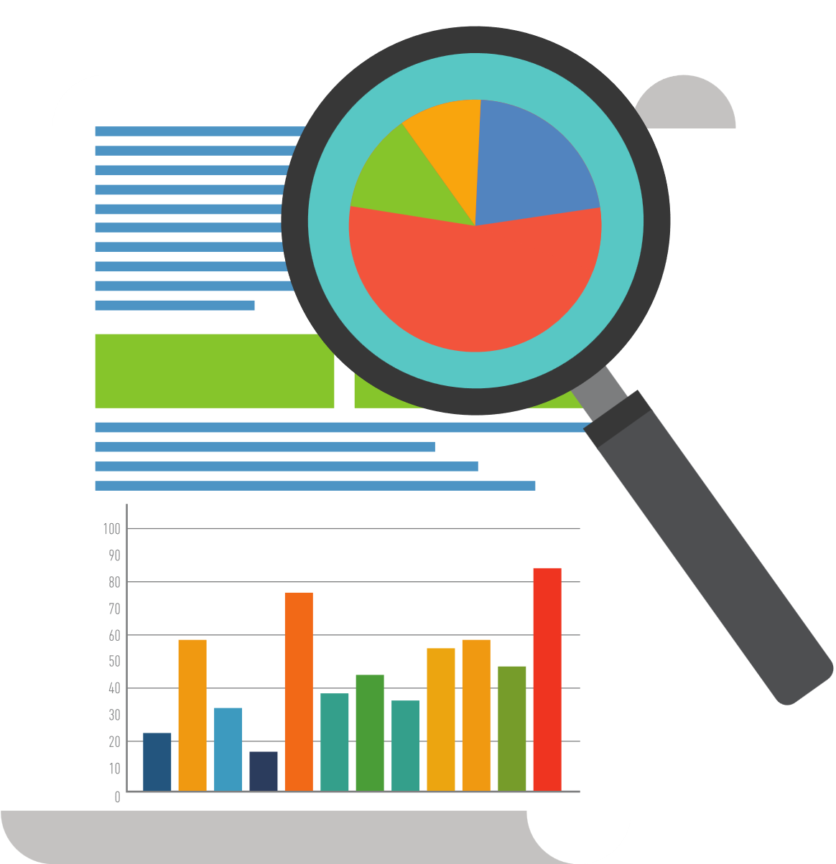
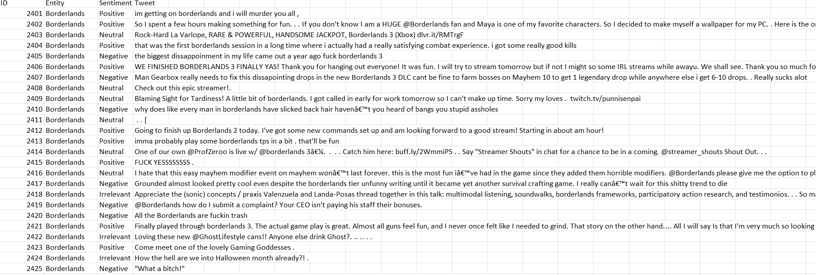
Data Cleaning and Pre-Processing
Fig. Raw Data

Slide 6
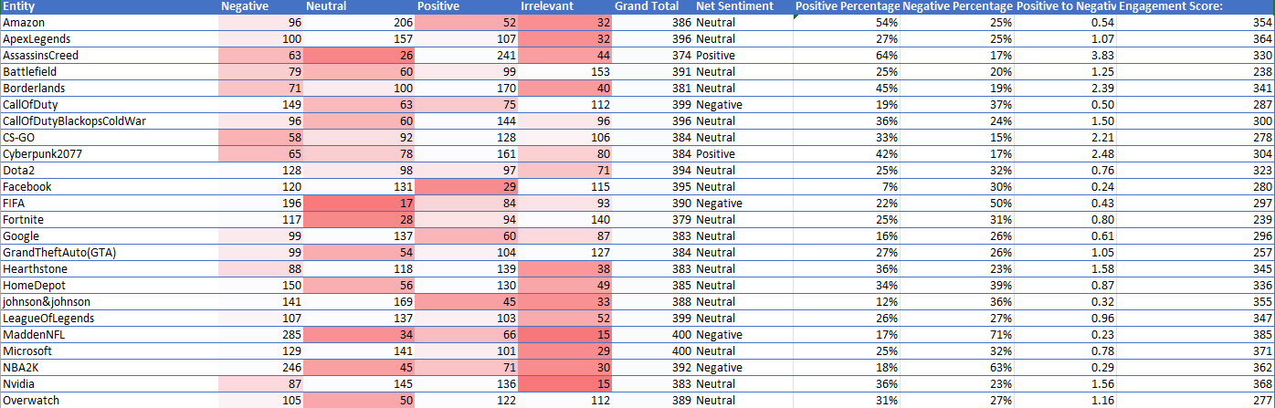
Fig. Cleaned Data

Slide 7

Methodology
Promotion Posts
1.Data Preprocessing
Removed missing or invalid entries.
Verified sentiment columns were numeric.
Standardized entity names for consistency.
2.Data Preparation
Manual cleaning done in Excel.
Removed aggregate rows like “Grand Total.”
Ensured uniform sentiment classification across entries.
3.Statistical Analysis
Calculated mean, median, mode, standard deviation, variance, range, and IQR.
Analyzed shape of data using skewness and kurtosis.
Computed 95% confidence intervals (especially for Negative sentiment).

Slide 8

4.Correlation & Regression
Pearson correlation to find relationships between sentiment types.
Linear regression (Negative → Positive sentiment) with coefficients and R².
5. Hypothesis Testing
Two-sample t-test comparing Positive and Negative sentiment means.
Result: Difference not statistically significant.
6.Visualization & Interpretation
Used Python libraries (Matplotlib, Seaborn) for visuals:
Bar charts, box plots, heatmaps, scatter plots, pair plots, stacked bar charts.
Aimed at making data insights clear for both technical and non-technical audiences.
Promotion Posts

Slide 9

Result
The analysis revealed that negative tweets constituted approximately 42% of the dataset, with positive and neutral tweets representing 33% and 25%, respectively. The best-performing machine learning model achieved an accuracy of 73%, with precision and recall scores around 0.72–0.74, indicating reliable sentiment classification. Correlation analysis highlighted a strong inverse relationship between positive and negative sentiment (r = –0.55), while regression modeling produced an R² of 0.30 and a p-value of 0.0011, indicating moderate predictive power and statistical significance. Additionally, sentiment analysis at the entity level identified topics like “MaddenNFL” and “NBA2K” as outliers, with significantly higher levels of negative sentiment compared to other topics.

Slide 10
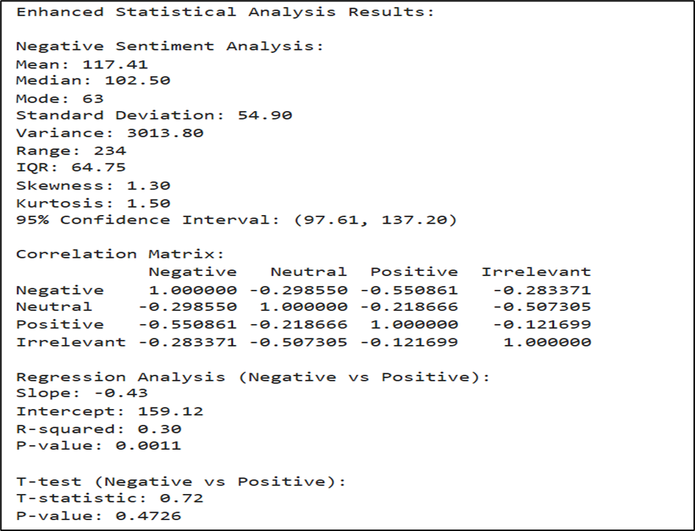
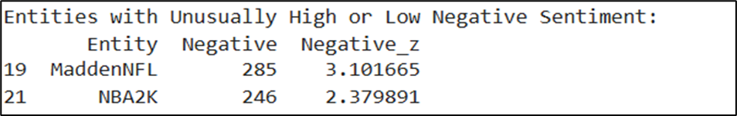
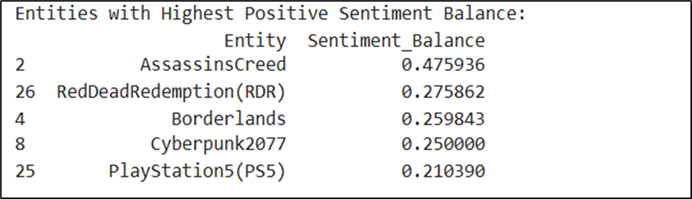

Slide 11
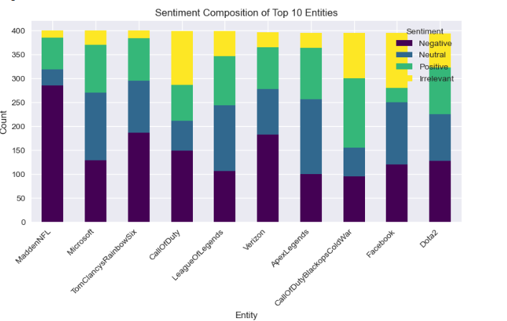
Visualizations
Rimberio
Stacked Bar Charts
Stacked bar charts were used to show the sentiment composition for each entity. Each bar was divided into colored segments representing Positive, Negative, Neutral, and Irrelevant tweets, making it easy to compare sentiment proportions across multiple entities side by side.

Slide 12
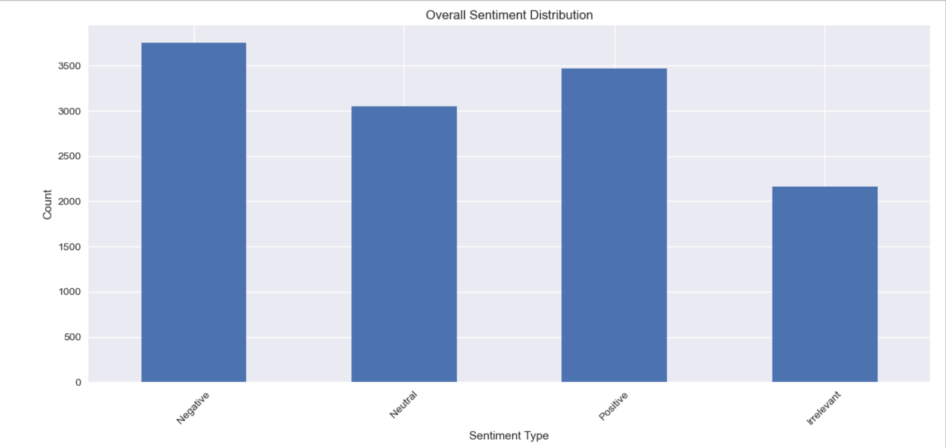
Rimberio
Bar Charts
Bar charts were used to display the total number of tweets under each sentiment category and to compare sentiment volumes across different entities. They helped quickly identify which entities had higher proportions of positive, negative, or neutral reactions, offering a straightforward overview of sentiment distribution.

Slide 13
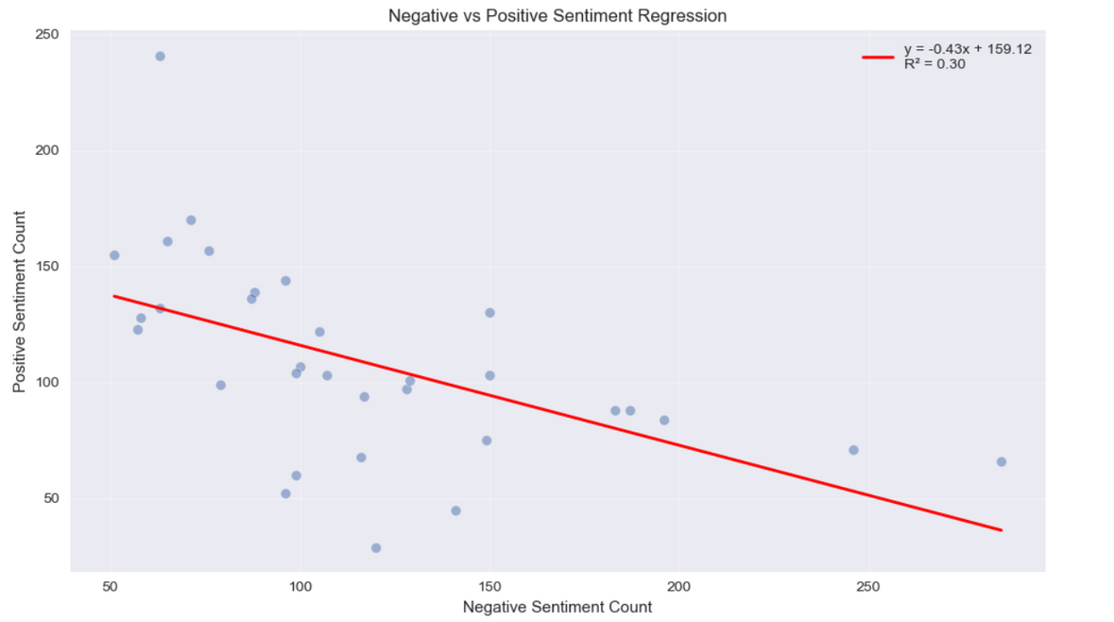
Rimberio
Scatter Plots with Regression Lines
Scatter plots plotted the relationship between Positive and Negative sentiments across entities. By adding a regression line, the chart showed the overall trend and helped visualize whether higher negative sentiment was associated with lower positive sentiment, supporting the regression analysis.

Slide 14
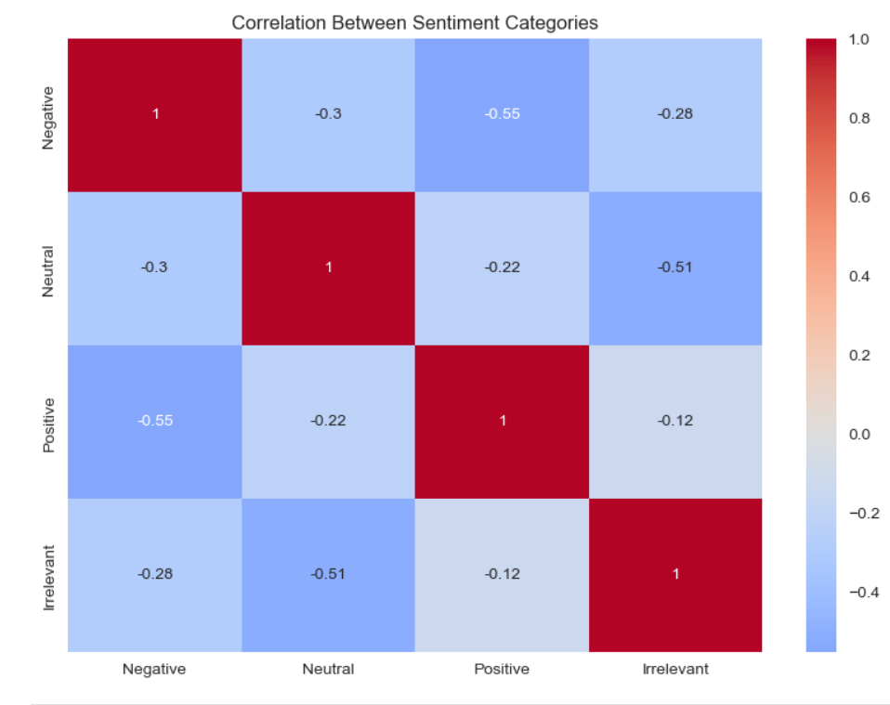
Rimberio
Heatmaps
Heatmaps visually represented the strength of correlation between different sentiment types (Positive, Negative, Neutral). The color intensity in the heatmap made it easy to detect strong, weak, or inverse relationships between sentiment categories at a glance.

Slide 15
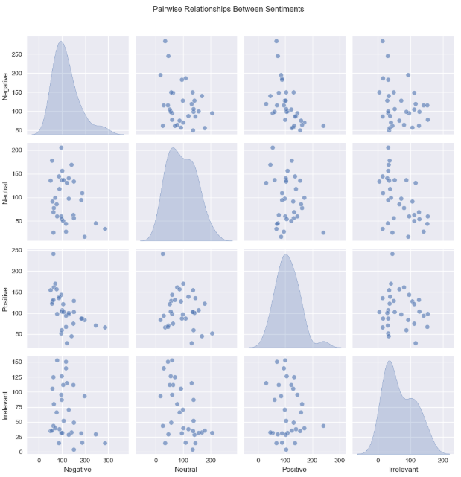
Rimberio
Pair Plots
Pair plots allowed a multivariate comparison of all sentiment types simultaneously. They displayed scatter plots for every pair of sentiment variables, making it easier to observe interaction patterns, clusters, and correlations in one compact view.

Slide 16
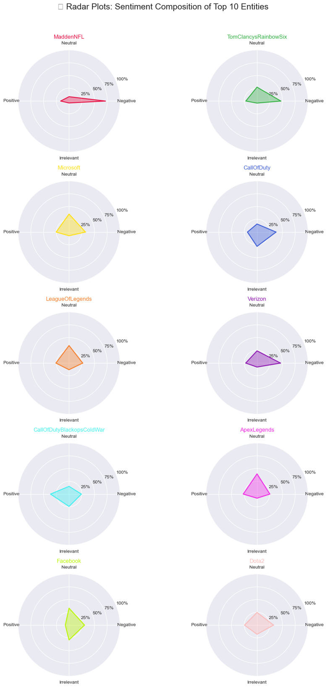
Radar Plots
Radar plots (also known as spider or web charts) are useful for comparing multiple variables across different categories on a single plot. In the context of this project, a radar plot could be used to visualize the sentiment distribution (Positive, Neutral, Negative, Irrelevant) for individual entities in a circular format. Each axis represents a sentiment type, and the plot forms a closed shape that highlights which sentiments are dominant or lacking for a particular brand. This format is especially helpful for side-by-side comparisons of sentiment profiles across several entities.
Rimberio

Slide 17
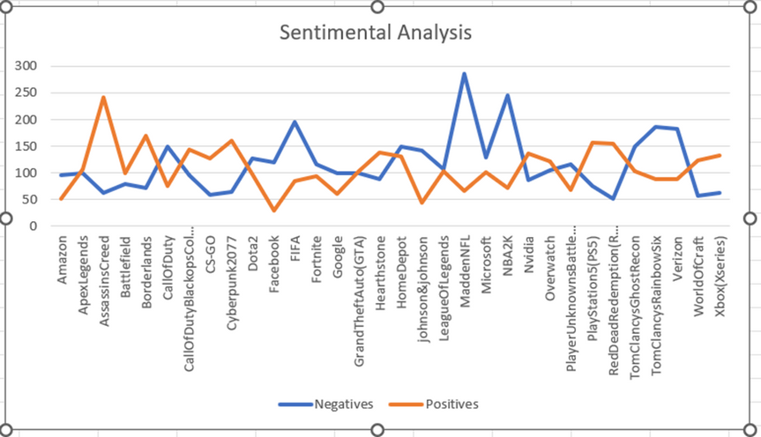
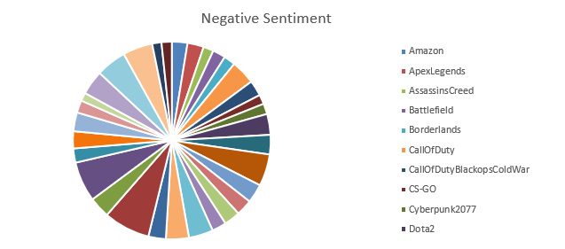
Rimberio
Microsoft Excel Visualizations

Slide 18

Conclusion
This project successfully conducted a sentiment analysis on public reactions using Twitter data. By collecting, cleaning, and analyzing tweets, we were able to extract meaningful insights into how the public perceives various entities and events. Using a combination of statistical methods, visualizations, and sentiment scoring techniques, we identified trends in emotional responses and verified sentiment relationships through correlation and regression. The results highlighted the importance of timely and adaptive sentiment monitoring for applications in public communication, health policy, and crisis management. Overall, the project demonstrates how social media analytics can provide real-time feedback and support decision-making processes by understanding public opinion in a data-driven way.

Slide 19

Project Summary

Slide 20
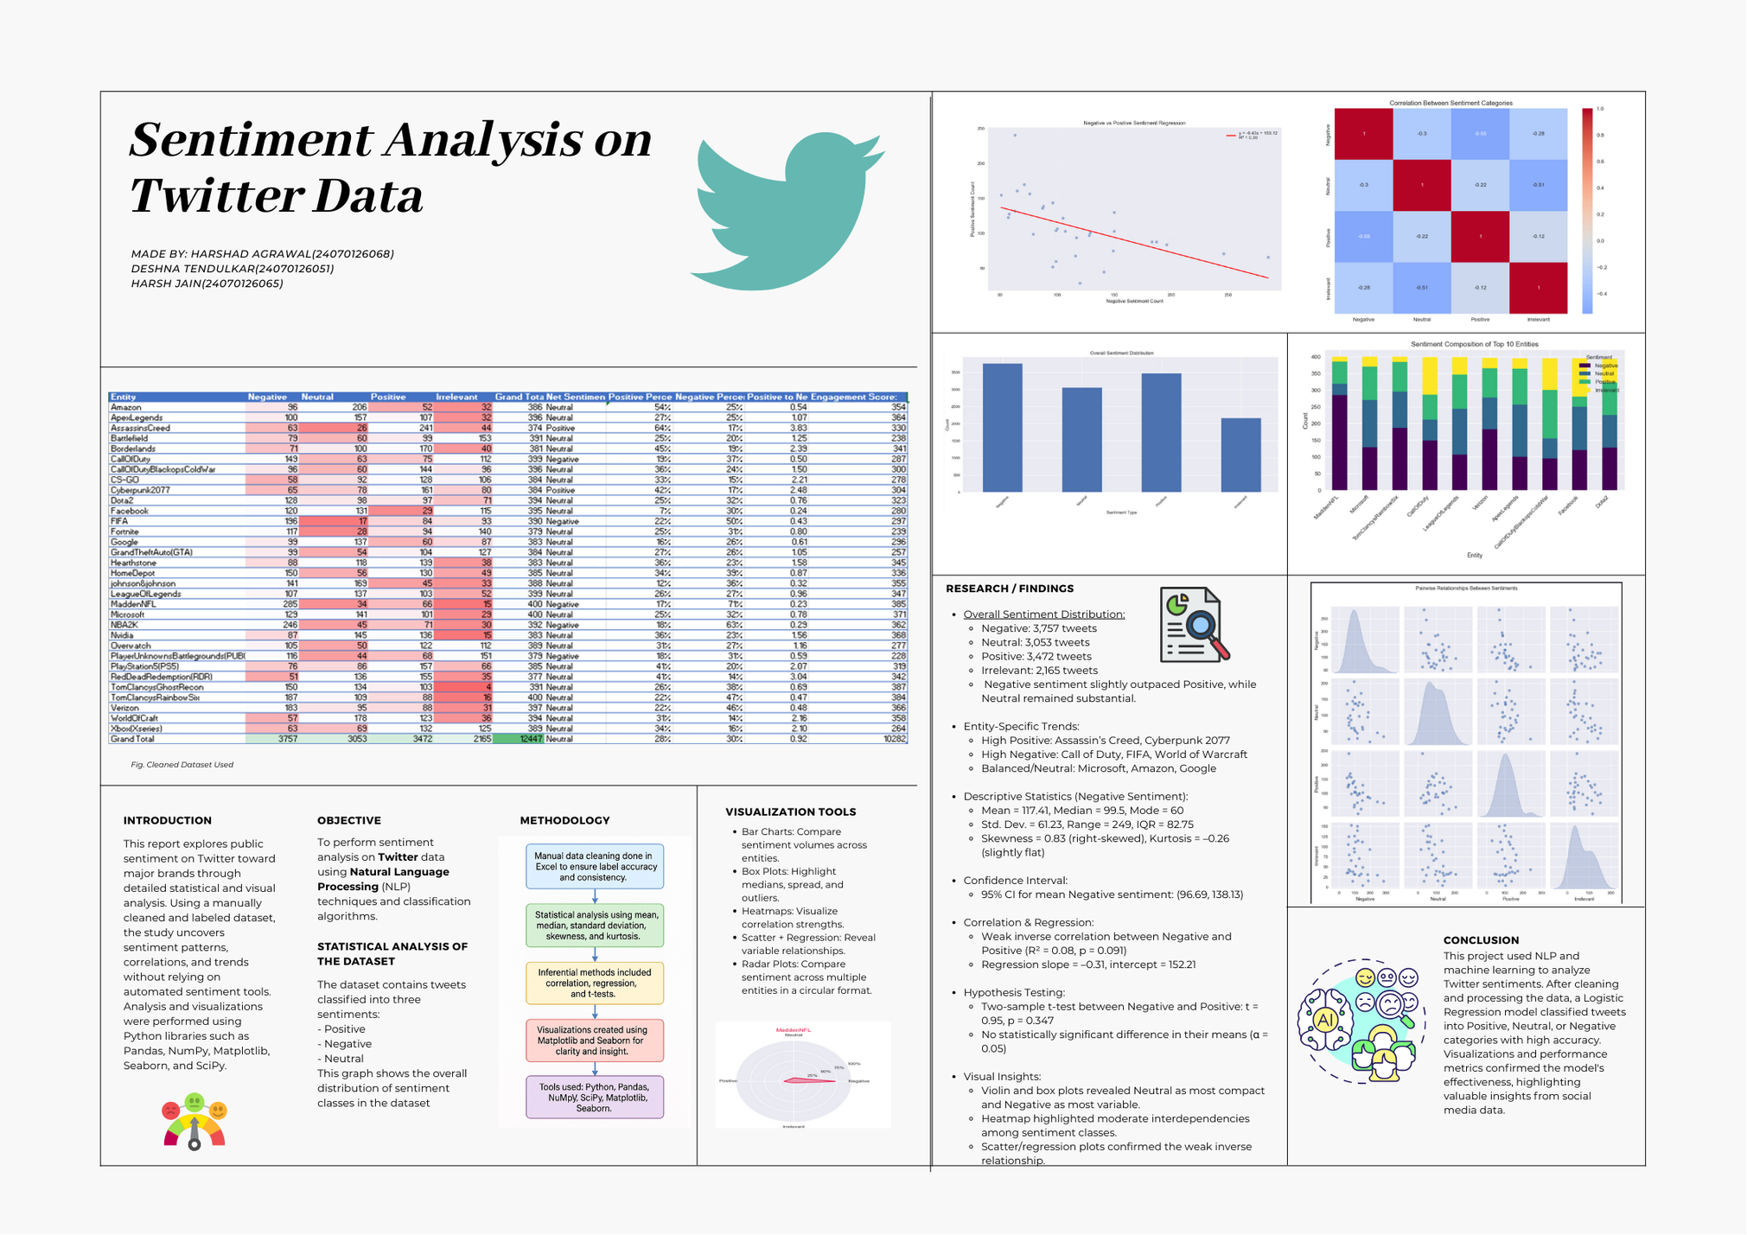

Slide 21


References
Pang, B., & Lee, L. (2008). Opinion Mining and Sentiment Analysis, Foundations and Trends in Information Retrieval, 2(1-2), 1-135.
Go, A., Bhayani, R., & Huang, L. (2009). Twitter Sentiment Classification using Distant Supervision, Empirical Methods in Natural Language Processing.
Medhat, W., Hassan, A., & Korashy, H. (2014). Sentiment Analysis Algorithms and Applications: A Survey, Ain Shams Engineering Journal, 5(4), 1093-1113.
Kim, Y. (2014). Convolutional Neural Networks for Sentence Classification, Empirical Methods in Natural Language Processing.
Twitter Developer Documentation. (2021). Twitter API Documentation. Available at: https://developer.twitter.com/en/docs

Slide 22

Rimberio
Presented By Rosa Maria Aguado
Address
123 Anywhere St., Any City

